Slide 1
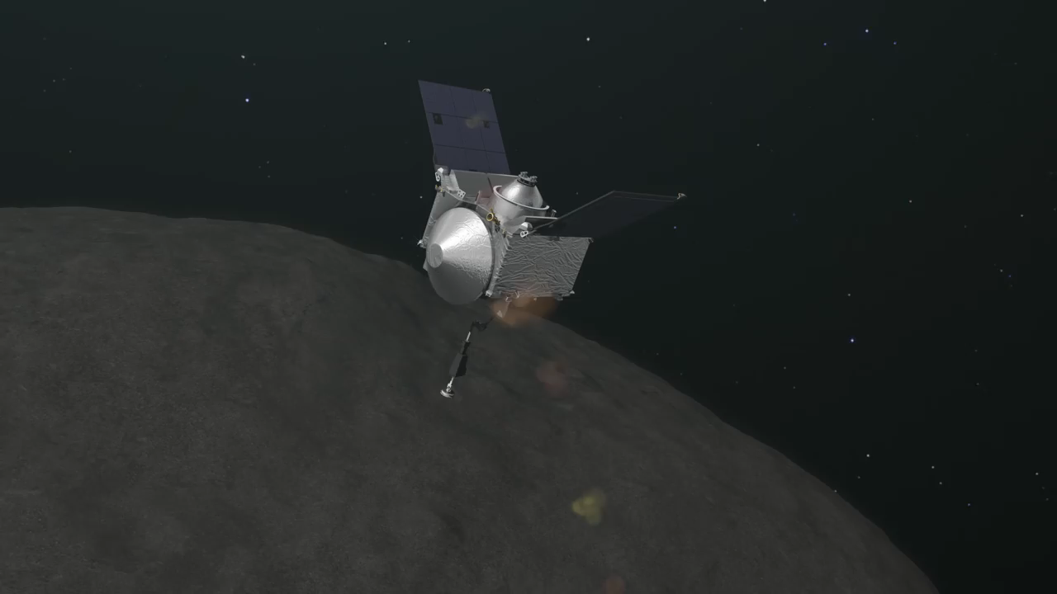

Autonomous Guidance for Asteroid Descent using Successive Convex Optimisation
Dual Quaternion Approach
S. Hazra
28th March 2019
Dr. ir. E. Mooij | TU Delft, Astrodynamics and Space Missions
Dr. ir. M. Sagliano | Deutsches Zentrum fur Luft-und Raumfahrt e.V.
Prof. dr. ir. P.N.A.M. Visser | TU Delft, Astrodynamics and Space Missions
Dr. ir. C. Visser | TU Delft, Controls and Simulations

Slide 2

Introduction to the Topic

Slide 3
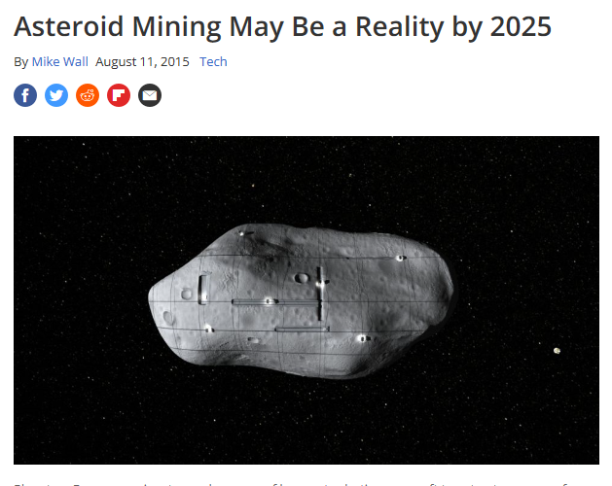
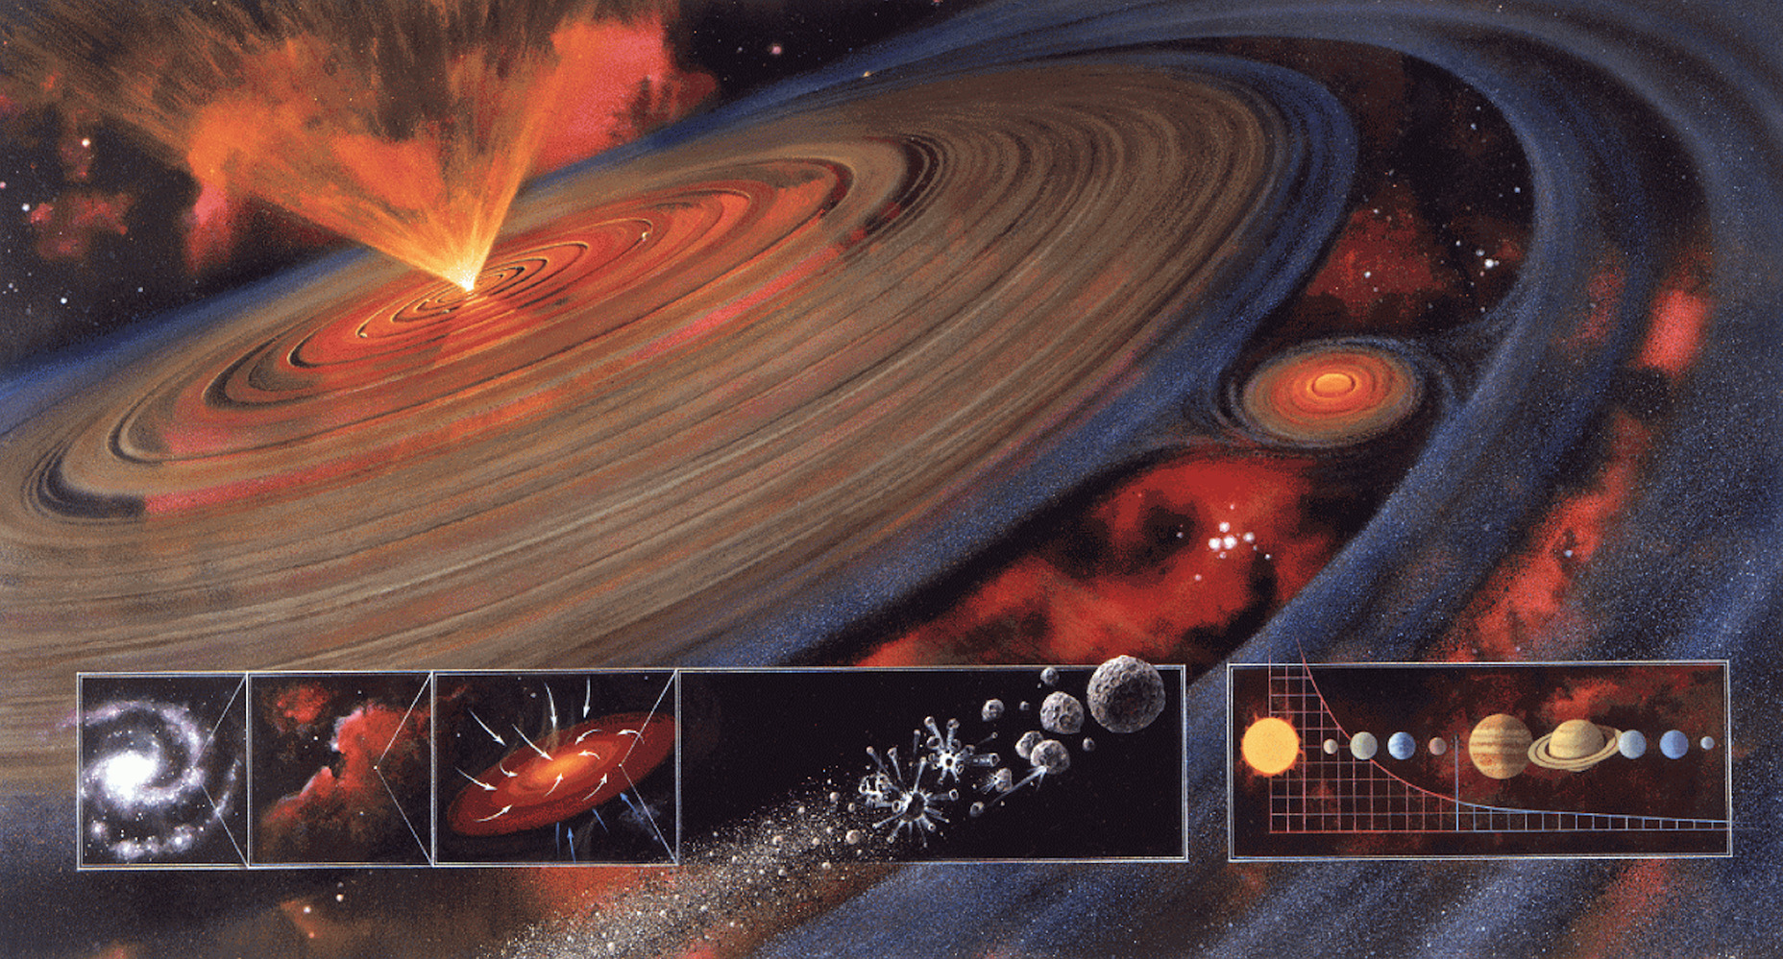
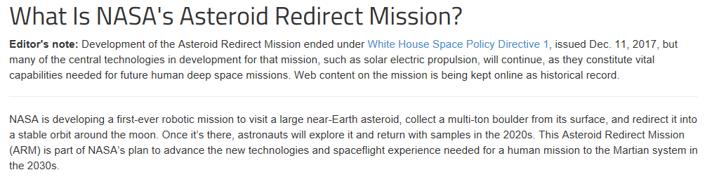
Why Asteroids?
Introduction
Research Question
Mission Overview
Methodology
Simulator Verification
Results
Conclusions
Recommendations
Notes:
Asteroids are pristine remnants from the planetary formation. The study of their composition can help understand the process better. They are plentiful in resources and stand as an option for mining.
Chelyabinsk impact, 20 m dia asteroid, shockwave across six cities. The threat of impact with Earth, requires missions like asteroid redirect mission. They are therefore a hot topic at present.

Slide 4
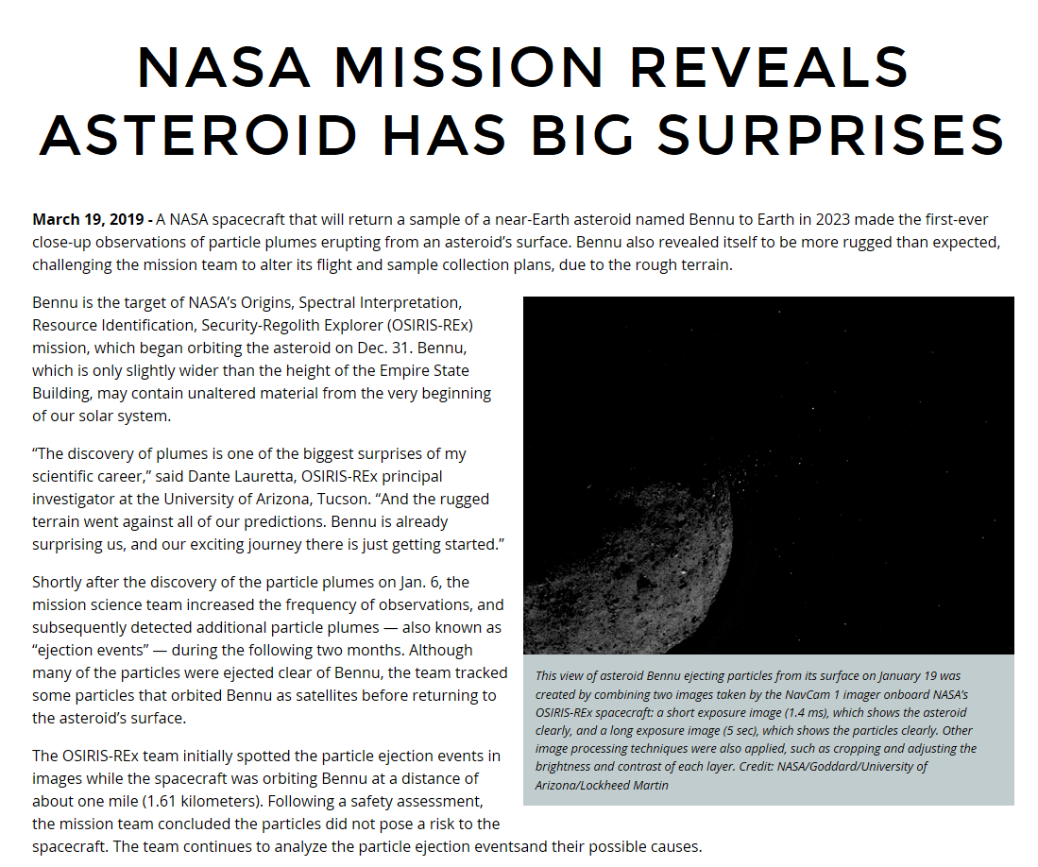
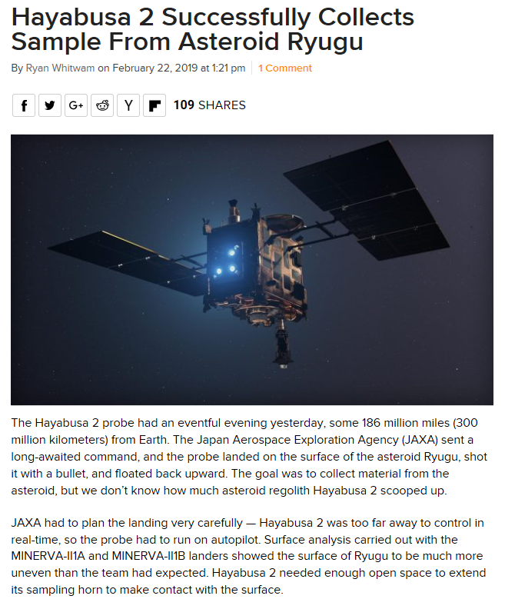
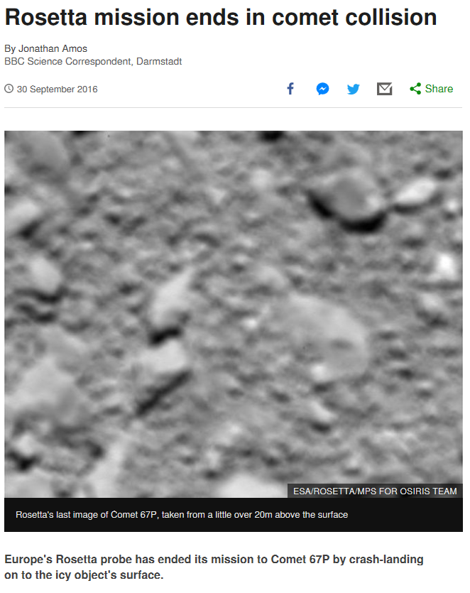
Recent Missions
OSIRIS-REx
Introduction
Hayabusa 2
Research Question
Mission Overview
Methodology
Simulator Verification
Results
Rosetta
Conclusions
Recommendations
Notes:
The most current missions to asteroids that have either conducted sampling missions or close proximity operations to small bodies are: . The current phases of these missions are as follows.
For this thesis we take inspiration from Osiris Rex and Rosetta, since we would like to present a solution for a sampling mission for MAB asteroids. (These are between Mars and Jupiter and also less weathered due to their further positioning from the sun as compared NEAs).

Slide 5
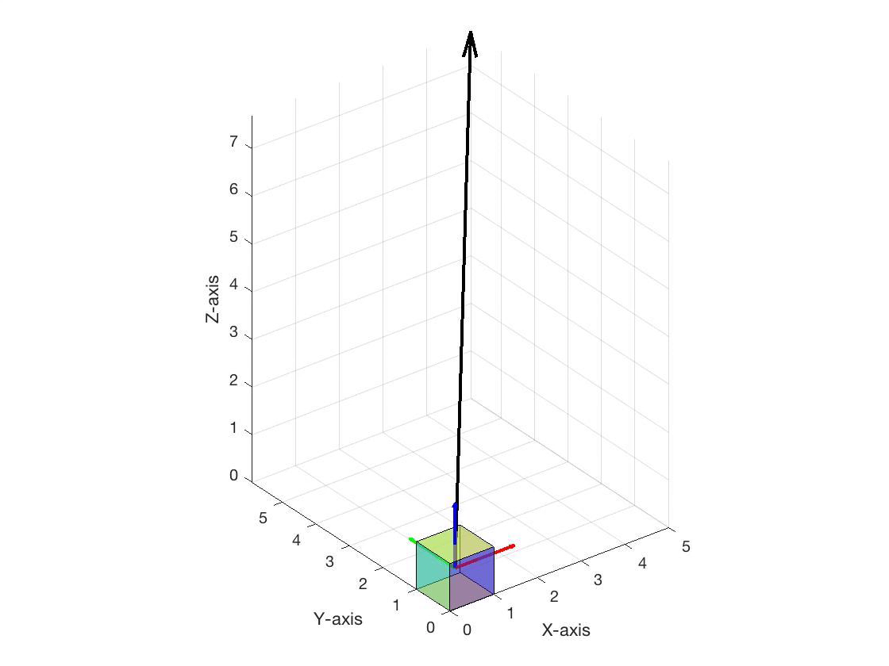
Why Dual Quaternions (DQs)?
Introduction
General 6DOF representation
Position: Cartesian coordinates
Attitude: Quaternion
Dual Quaternion 6DOF representation
Position: Quaternion
Attitude: Quaternion
Research Question
Mission Overview
Methodology
Simulator Verification
Results
Conclusions
Recommendations
Characteristics of dual quaternions
One transformation for both rotation and translation
Compact representation of 6DOF kinematics and dynamics
Similar properties as quaternions
Figure 1: Animation of DQ motion
Notes:
Others available for attitude: Euler rotation, MRPs
Dual quaternions: 8 tuple representation, one transformation for both rotation and translation

Slide 6
Why Autonomous Guidance?
Introduction
Research Question
A priori information about asteroids is limited
Perturbed and variable environment
Shapes, rotation rates and densities might be irregular or variable
Distance from Earth around 1.1-2 au
Mission Overview
Methodology
Simulator Verification
Results
Conclusions
Recommendations
Notes:
1. shape, size, rotation rates, densities etc
2. Highly perturbed, Non central gravity field – SRP – 3BP– stable orbits can turn to crashing or escape orbits (seen in mission also Philae)
3. fast rotation – dynamics unpredictable
4. MAB – 2.1 to 3 au, communication ~17 to 33 mins, remote operation costly, delay in comm in unforeseen circumstances (The further we go from the sun, the sampled material becomes more and more primitive. )
5. Restrictions on SC design for fuel requirements

Slide 7
What are the Available Optimisation Methods for Guidance?
Introduction
Research Question
Mission Overview
Selected Autonomous Guidance Technologies
Successive Convex Optimisation
Sampling Based Model Predictive Optimisation
Pseudospectral Methods
Artificial Potential Functions
Convex Optimisation
Sampling Based Motion Planning
Methodology
Simulator Verification
Results
Conclusions
Recommendations
Notes:
Pavone et al researched this well. They have put forth the most interesting technologies for further research in autonomous applications for far-Earth missions.
We select these two methods since they have some added advantages, which we will discuss in the methodologies.

Slide 8
Research Question

Slide 9
How can a spacecraft autonomously descend for a touch-and-go sampling process to a chosen landmark robustly and optimally, while being accurate and safe?
Introduction
Research Question
Mission Overview
Methodology
Simulator Verification
Results
Conclusions
Recommendations

Slide 10
Mission Overview

Slide 11
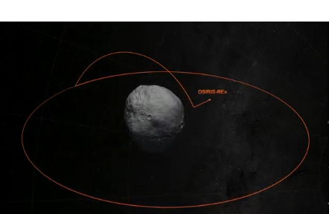
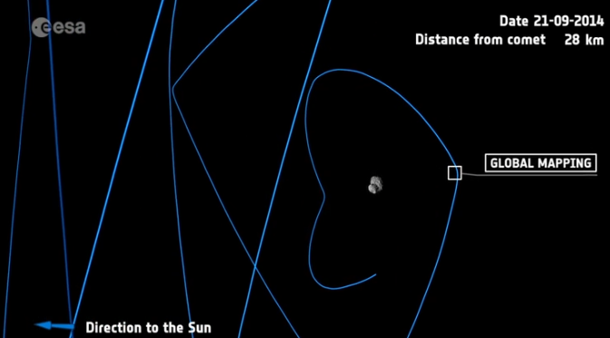
Which Mission Phases?
Introduction
Asteroid Descent
Asteroid Mapping
Research Question
Mission Overview
Methodology
Simulator Verification
Results
Conclusions
Recommendations
Figure 2: OSIRIS-REx descent phase (left) and Rosetta mapping phase (right)

Slide 12
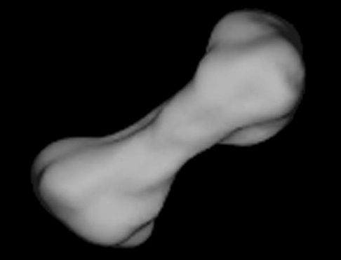
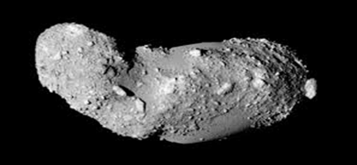
Which Asteroids?
Introduction
Research Question
Mission Overview
Methodology
Simulator Verification
Results
Figure 3: Kleopatra (left) and Itokawa (right). (Not to scale)
Conclusions
Recommendations
Distances: 2.79 au and 1.32 au
Maximum Dimension: 217 km and 0.5 km
Densities: ~6000 kg/m^3 and ~2000 kg/m^3
Rotation periods: 5.385 h and 12.132 h
Notes:
Sufficient property models available and Varied sizes, K at 2.79 au, I at 1.32 au, K- 217 km ,I - 0.5 km, densities K - 6000 kg/m^3,

Slide 13
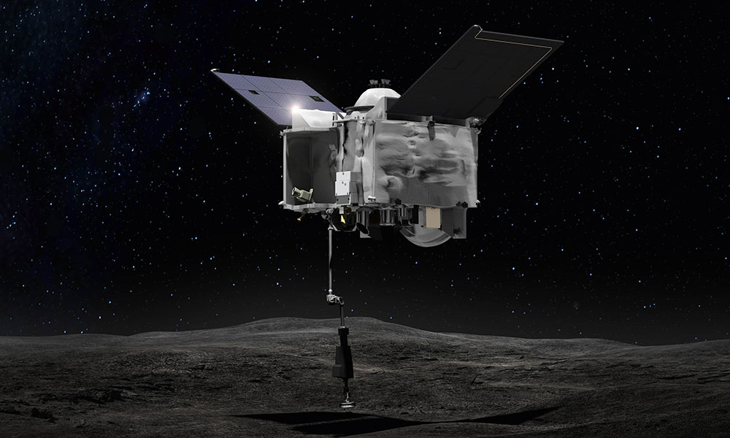
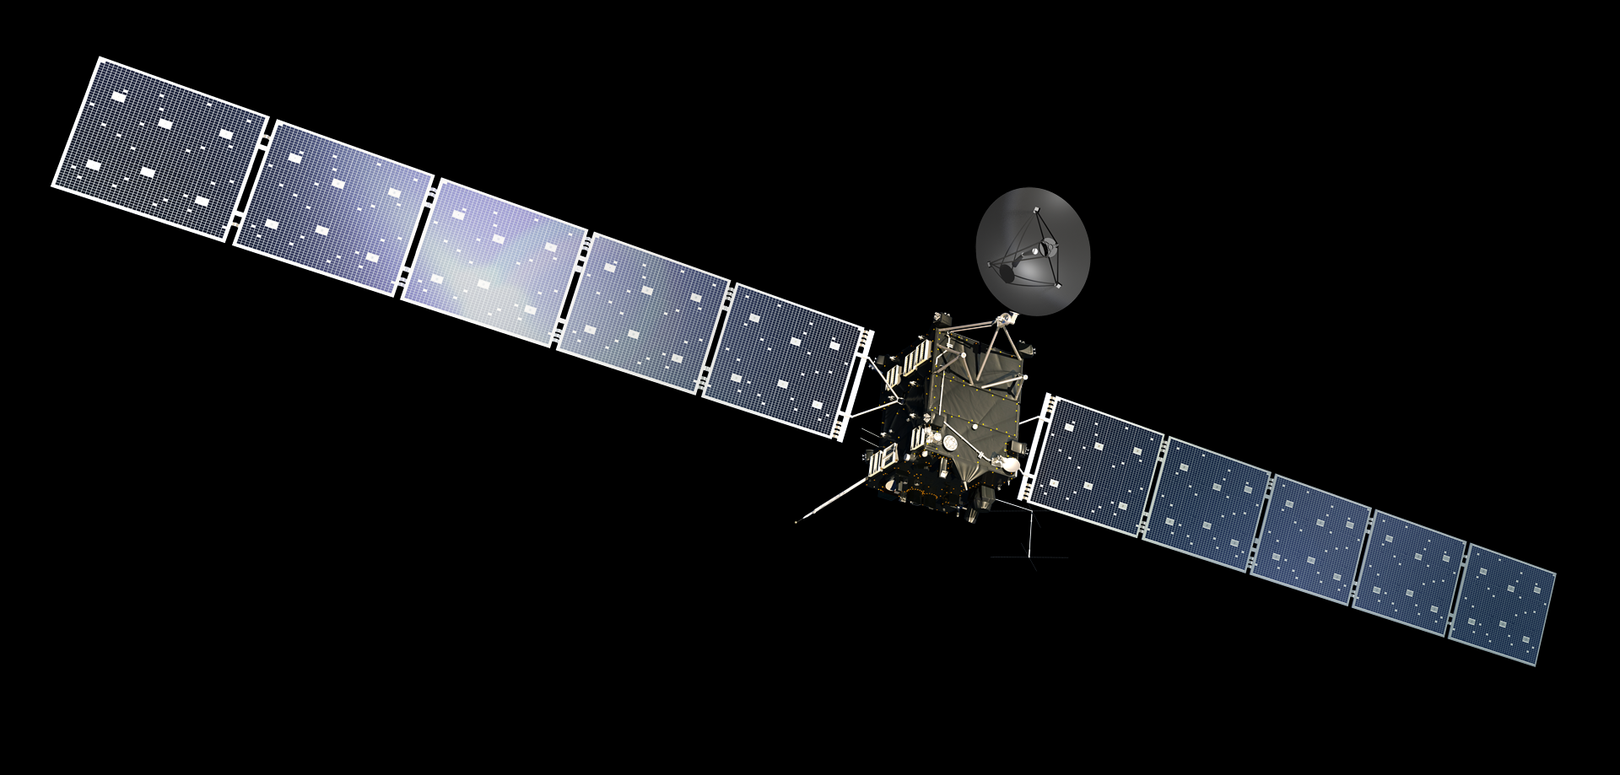
Which Spacecrafts (SCs)?
Introduction
Research Question
Mission Overview
Methodology
Simulator Verification
Results
Figure 4: OSIRIS-REx (left), Rosetta (right). (Not to scale)
Conclusions
Recommendations
SC Block: similar size
Solar Arrays: 1.9 x 2.3 m and 14 x 3 m
Launch Masses: 2110 kg and 2900 kg
Sample collector: 3.5 m and absent
Notes:
Able to operate at a distance of 1.2~3 au from the Sun, Able to conduct descent on a small Solar System body

Slide 14
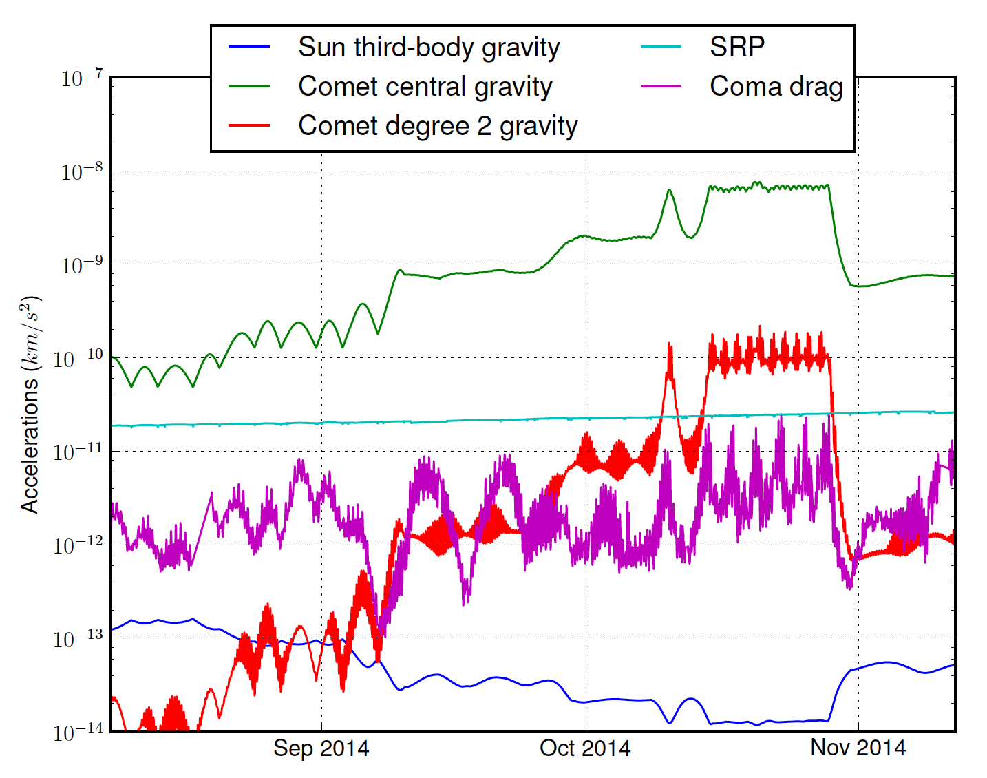
What is the Environment like?
Introduction
Research Question
External disturbances
Perturbed gravity
Solar Radiation Pressure
Third Body Perturbation
Mission Overview
Methodology
Simulator Verification
Results
Conclusions
Recommendations
Coma drag
Figure 5: Gravitational and perturbing accelerations on Rosetta, while performing close proximity operations at Comet 67P.
Notes:
Internal disturbances: Flexible dynamics, Sloshing (not included due to complicated nature and structural details needed and time constraints)

Slide 15
RQ 1 How can the SC attitude and orbital dynamics be represented by dual quaternions?
Notes:
Asteroids are pristine remnants from the planetary formation. The study of their composition can help understand the process better. They are plentiful in resources and stand as an option for mining.
Chelyabinsk impact, 20 m dia asteroid, shockwave across six cities. The threat of impact with Earth, requires missions like asteroid redirect mission. They are therefore a hot topic at present.

Slide 16
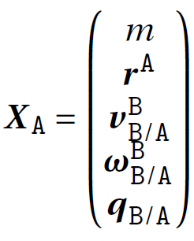
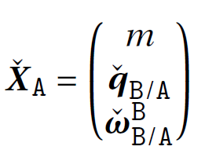
SC State Vectors
General 6DOF representation:
Introduction
Research Question
Mission Overview
Methodology
Simulator Verification
Results
Conclusions
DQ 6DOF representation:
Recommendations

Slide 17
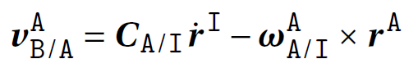
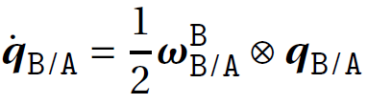
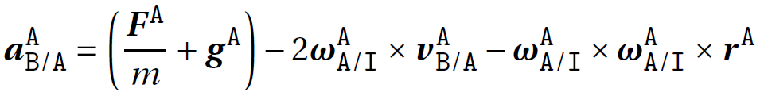
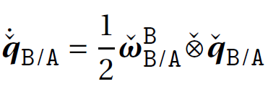
SC Kinematics and Dynamics in the Asteroid Rotating Frame of Reference (A)
Introduction
General 6DOF representation:
Research Question
Translational and Rotational Kinematics:
Mission Overview
Methodology
Simulator Verification
Translational and Rotational Dynamics:
Results
Conclusions
DQ 6DOF representation:
Recommendations
Translational and Rotational Kinematics:
Translational and Rotational Dynamics:

Slide 18
RQ 2 What are the cost functions that need to be optimised, the constraints they are subject to and how can they be formulated with dual quaternions?
Notes:
Asteroids are pristine remnants from the planetary formation. The study of their composition can help understand the process better. They are plentiful in resources and stand as an option for mining.
Chelyabinsk impact, 20 m dia asteroid, shockwave across six cities. The threat of impact with Earth, requires missions like asteroid redirect mission. They are therefore a hot topic at present.

Slide 19
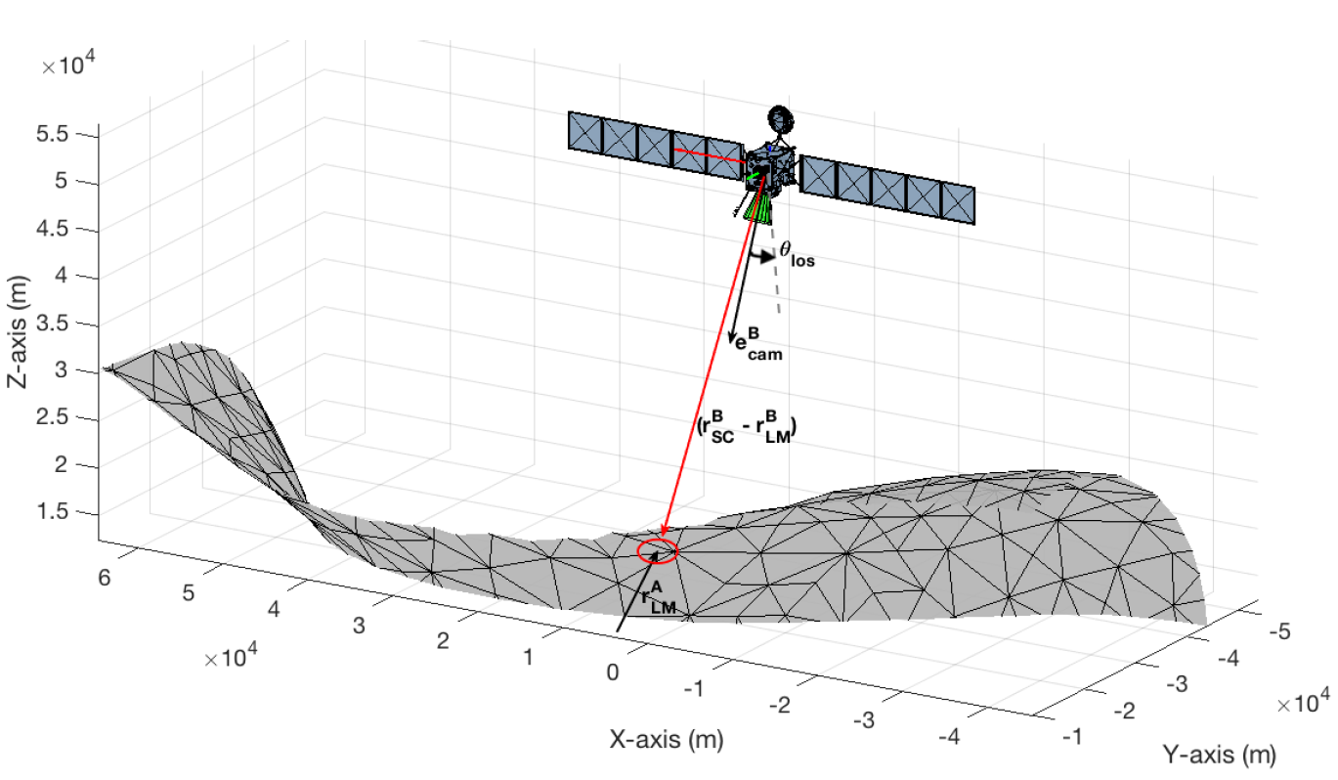
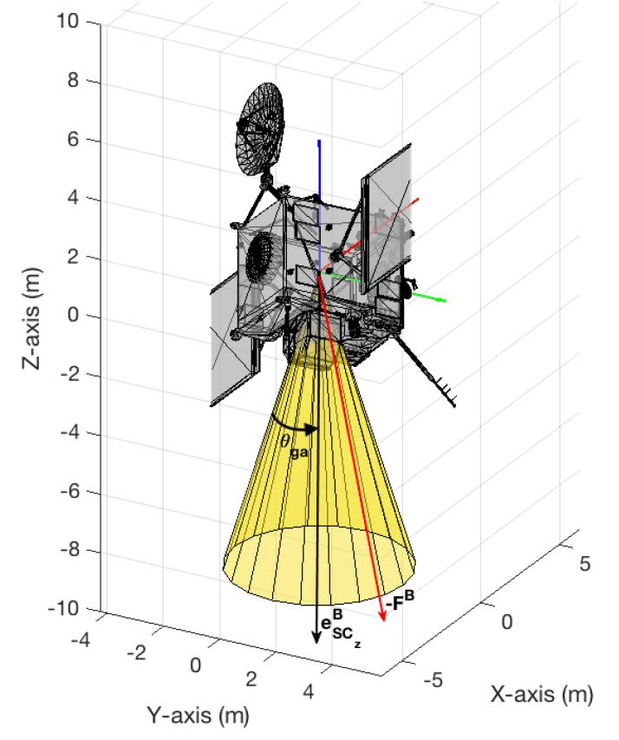
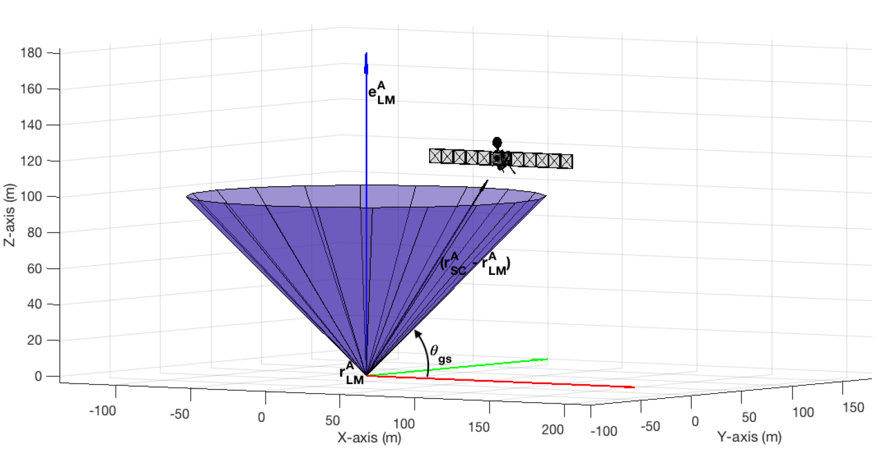
What is required from the Descent Guidance Algorithm?
Introduction
Research Question
Minimum propellant consumption
Constrained SC altitude
Constrained SC attitude
Constrained SC angular rate
Constrained SC thrust
Optimal descent trajectory
Mission Overview
Methodology
Simulator Verification
Results
Conclusions
Recommendations
Figure 6: Physical representation of the glide-slope constraint.
Figure 7: Physical representation of the line of sight constraint.
Figure 8: Physical representation of the gimbal angle constraint.

Slide 20
RQ 3 How can successive convex optimisation (SCvx) be implemented to optimise the derived cost functions?
Notes:
Asteroids are pristine remnants from the planetary formation. The study of their composition can help understand the process better. They are plentiful in resources and stand as an option for mining.
Chelyabinsk impact, 20 m dia asteroid, shockwave across six cities. The threat of impact with Earth, requires missions like asteroid redirect mission. They are therefore a hot topic at present.

Slide 21
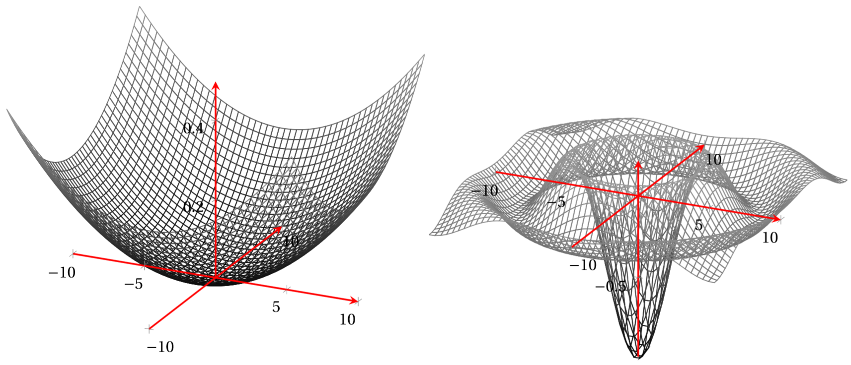
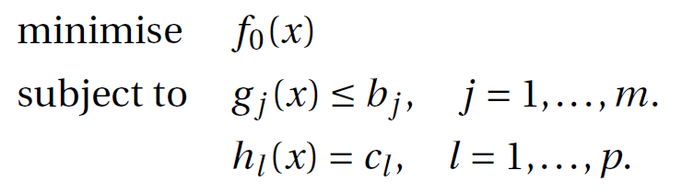
What is Convex Optimisation?
Introduction
General optimal control problem:
Global Minimum
Local Minima
Objective/Cost function
Research Question
Global Minimum
Mission Overview
Inequality constraints
x₂
Methodology
x₁
Equality constraints
Simulator Verification
x₁
x₂
Results
Conclusions
The cost function, inequality and equality constraints can be linear or non-linear.
An asteroid descent problem is ridden with these non-linearities.
Non-linear kinematics and dynamics
Non-linear state constraints (both equality and inequality)
Non-linear control constraints
Recommendations
Figure 9: Representations of a convex and non-convex function in 3D. (solid structures)
Notes:
A parabola is used to represent a convex function in Figure 6.5a, since it is easy to visualise, but it does not generalise convexity. In reality, convex sets are not intuitive or easy to visualise.
The selection of the different methods depends on the type of the OCP, As we will explain in the next slide linear programming is not an option, SDP involves semidefinite positive matrices, SOCP involves Second order cone

Slide 22
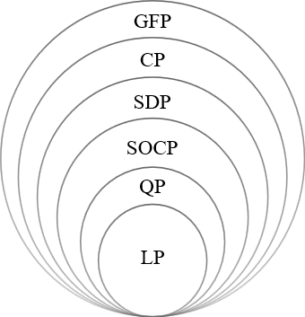
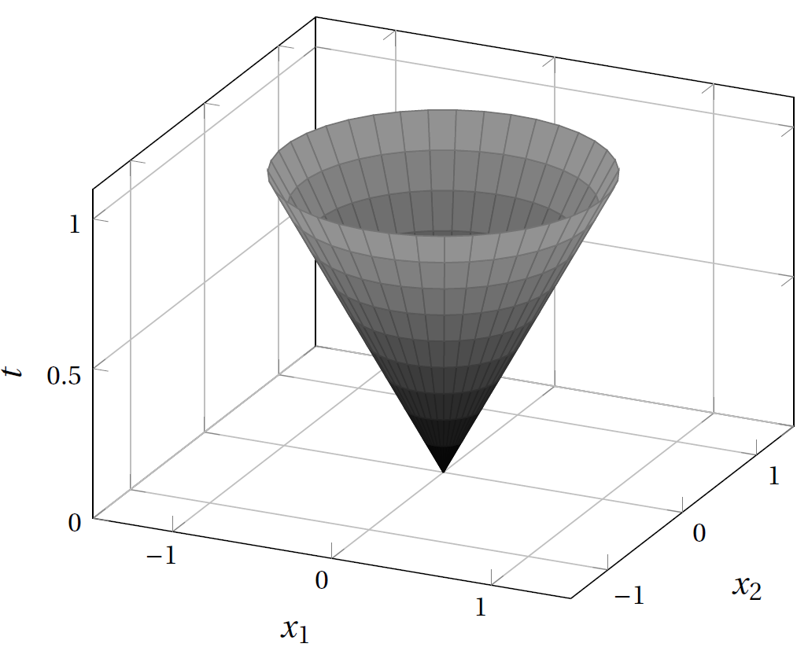
Convex Optimisation Techniques
Introduction
Research Question
Linear Programming
Quadratic Programming
Second Order Conic Programming
Semi-Definite Programming
Conic Programming
Graph Form Programming
Mission Overview
Methodology
Simulator Verification
Results
Conclusions
Recommendations
Figure 11: Second order cone boundary. It represents a filled cone.
Figure 10: Hierarchy of convex optimization problems.
Notes:
The obvious reason for using convex optimisation is the necessary existence of only one global minimum for convex function over its domain. The probability of getting stuck at a local minimum is, therefore, nil. Also, the negative gradient of the function will always lead to the optimum.

Slide 23
Successive Convex Optimisation
Introduction
Effects of linearisation
Artificial infeasibility
Unboundedness
Research Question
Linearise nonconvexities in the dynamics and constraints about a solution state from previous iteration
Discretise the dynamics at every iteration
Mission Overview
Methodology
Simulator Verification
Results
Solutions to artificial infeasibility and unboundedness
Virtual controls
Trust Region
Conclusions
Recommendations
Figure 12: Non-linear function f1 linearised to first order f2 at x=1.
Notes:
New cost function has to be penalised

Slide 24
Problems with Successive Convex Optimisation and its Solution
Introduction
Research Question
Trust region becomes a hard constraint.
Infeasibility with poor initialisation if trust region radius is too small.
Linearisation error if trust region radius is too large.
Dynamic penalty to make it a soft constraint.
Dynamic Successive Convex Optimisation
Comparing the actual non-linear cost with the linear cost to evaluate quality of solution
Penalty weight is reduced with a better prediction of actual non-linear cost and increased with a poor prediction.
Mission Overview
Methodology
Simulator Verification
Results
Conclusions
Recommendations
Notes:
If eta too large, linearisation error whereas if its too small

Slide 25
RQ 4 How can sampling based model predictive optimisation (SBMPO) be used to map an asteroid autonomously to provide the SC with a safe landmark for descent?
Notes:
Asteroids are pristine remnants from the planetary formation. The study of their composition can help understand the process better. They are plentiful in resources and stand as an option for mining.
Chelyabinsk impact, 20 m dia asteroid, shockwave across six cities. The threat of impact with Earth, requires missions like asteroid redirect mission. They are therefore a hot topic at present.

Slide 26
Sampling Based Model Predictive Optimisation
Introduction
Research Question
Mission Overview
Methodology
Figure 13: Sampling based motion planning flowchart
Simulator Verification
Results
Configuration space sampling
Obstacle space
Physical system
Mission objectives and outcomes
Conclusions
Recommendations
Figure 14: State transition graph for moving from initial to final state

Slide 27
Simulator Verification

Slide 28
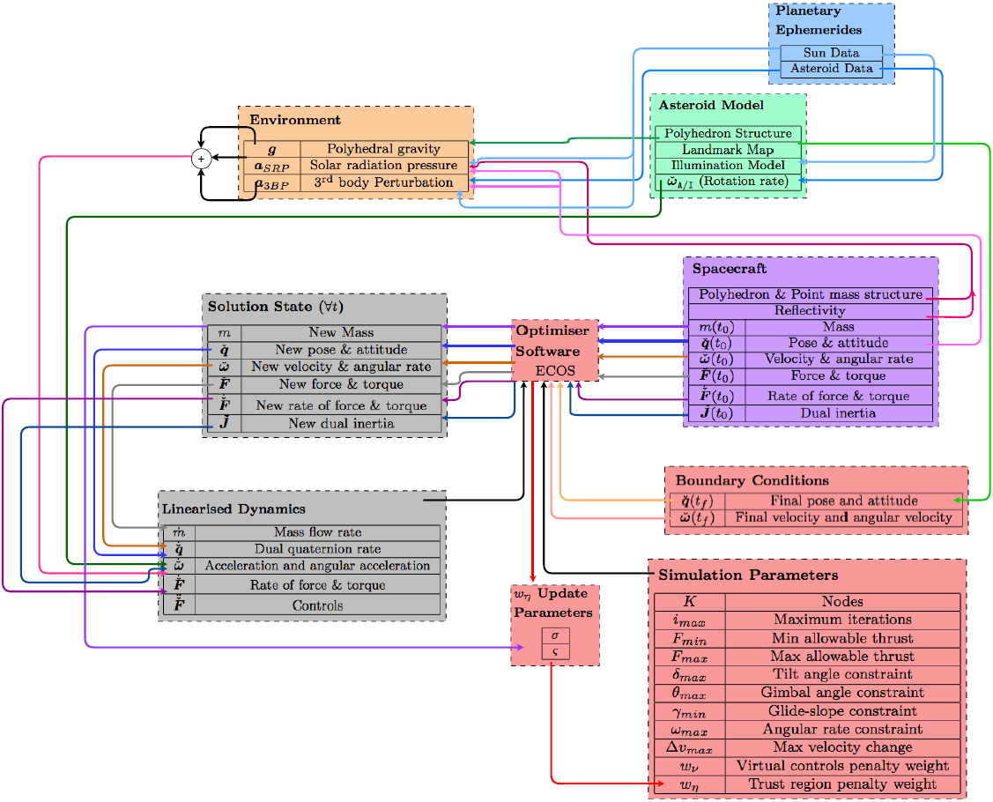
Simulator Architecture
Introduction
Research Question
Mission Overview
Methodology
Simulator Verification
Results
Conclusions
Recommendations
Figure 15: Simulator Architecture for Descent Guidance

Slide 29
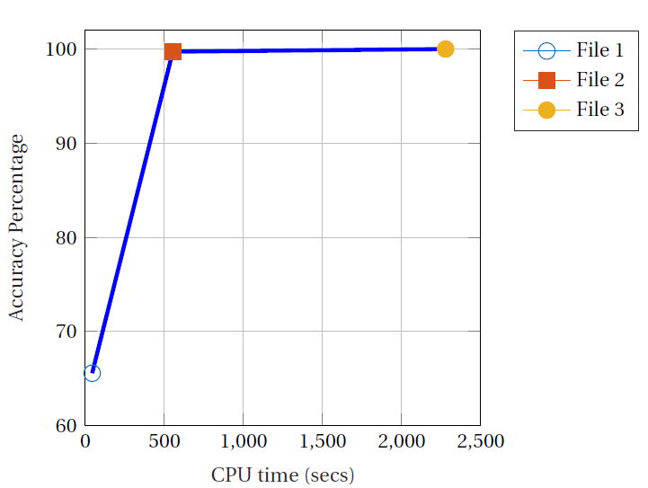
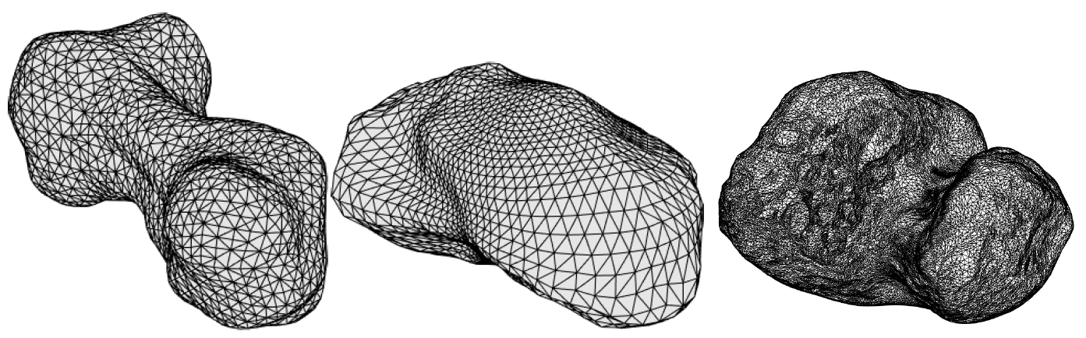
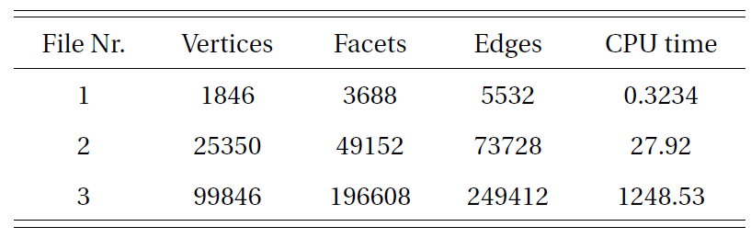
Asteroid Structure Models
Introduction
Research Question
Mission Overview
Methodology
Simulator Verification
Results
Figure 16: Polyhedron asteroid models of Kleopatra, Itokawa and Comet 67P (left to right). (not to scale)
Conclusions
Figure 17: Accuracy of computed polyhedron gravity compared to CPU computational time for 50 nodes and 10 iterations.
Recommendations
Table 1: Itokawa polyhedron files and their CPU time for computation

Slide 30
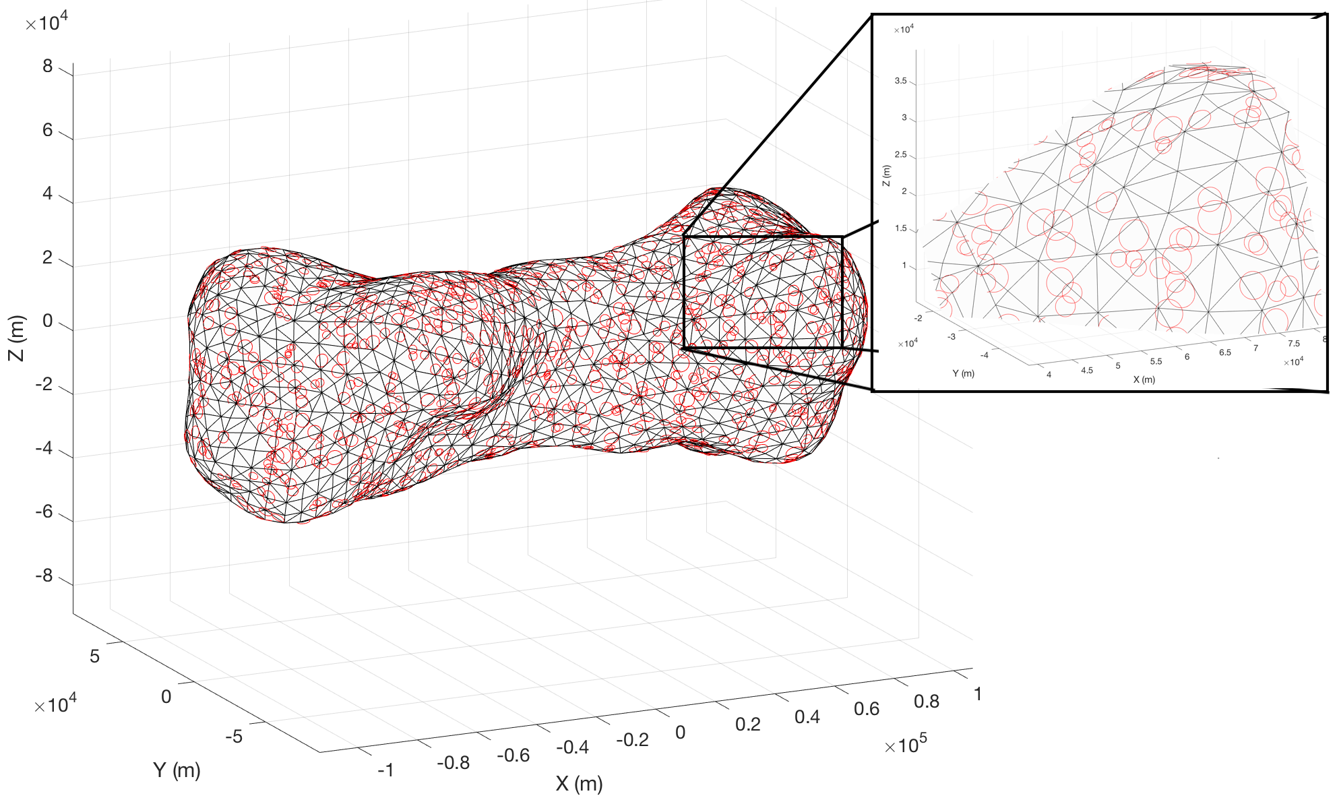
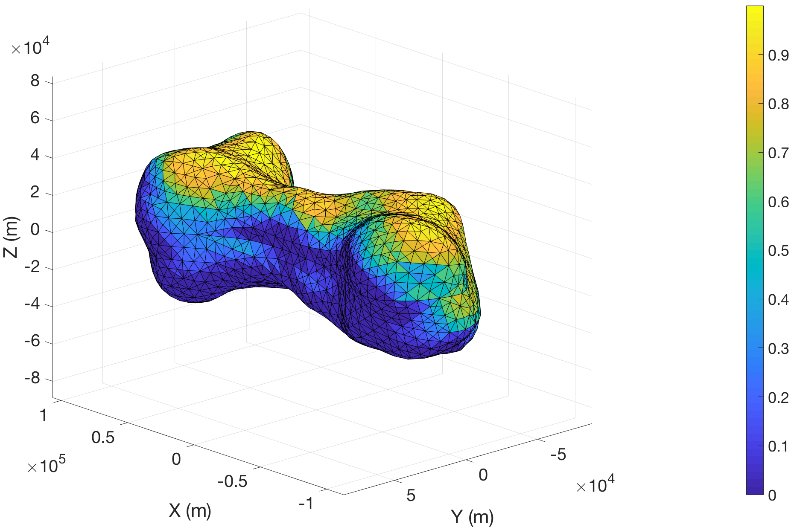
Additional Asteroid Models for Mapping
Introduction
Research Question
Mission Overview
Methodology
Simulator Verification
Results
Conclusions
Recommendations
Figure 18: Illumination model of Kleopatra based on ephemerides data and surface normals.
Figure 17: A priori landmark map for Kleopatra. 2000 landmarks with varied number of landmarks per polyhedron.

Slide 31
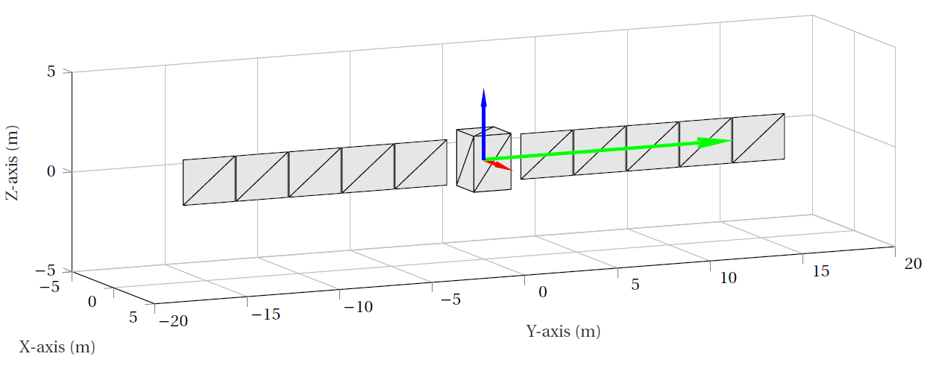
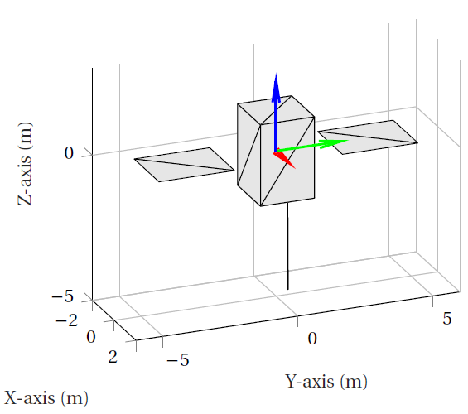
SC Structure Models
Introduction
Research Question
Mission Overview
Methodology
Simulator Verification
Results
Figure 19: Rosetta simplified polyhedron structure.
Conclusions
Recommendations
Figure 20: Rosetta with folded solar arrays
simplified polyhedron structure.

Slide 32
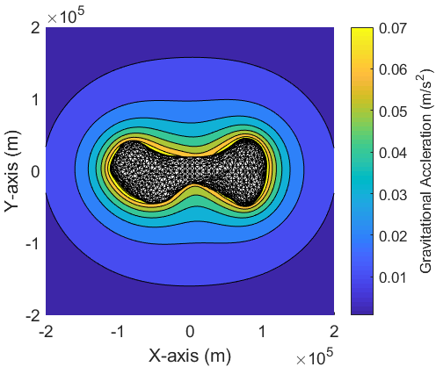
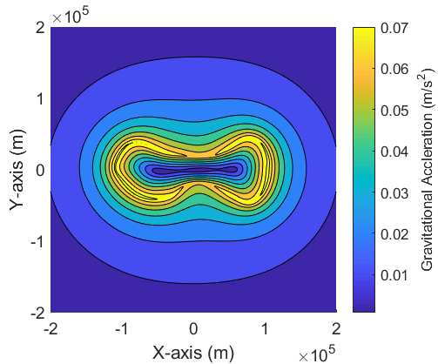
Gravity Models
Introduction
Research Question
Mission Overview
Methodology
Simulator Verification
Results
Conclusions
Recommendations
Figure 22: Polyhedral gravitational acceleration of Kleopatra till 20 kms.

Slide 33
Derived DQ Kinematics and Dynamics in Asteroid Rotating Frame (A) and SC Body Centred Frame (B)
Introduction
Research Question
Mission Overview
Methodology
Simulator Verification
Results
Conclusions
Recommendations
Figure 23: Overlay of rA and rB from the Q and DQ integrator and the magnified images to view the error. The difference is within the range of 4E-5 m

Slide 34
Simulator Verification: Dynamic SCvx Algorithm

Slide 35
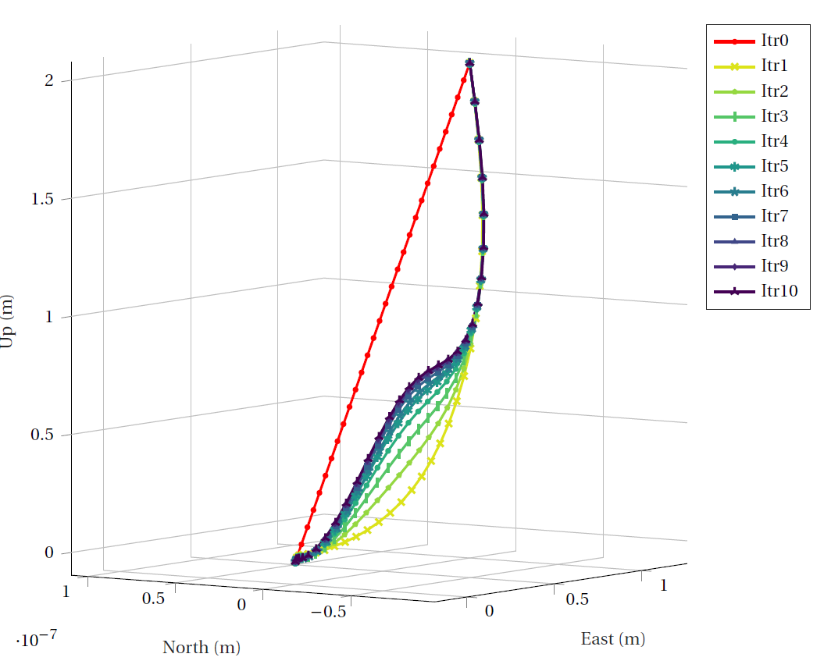
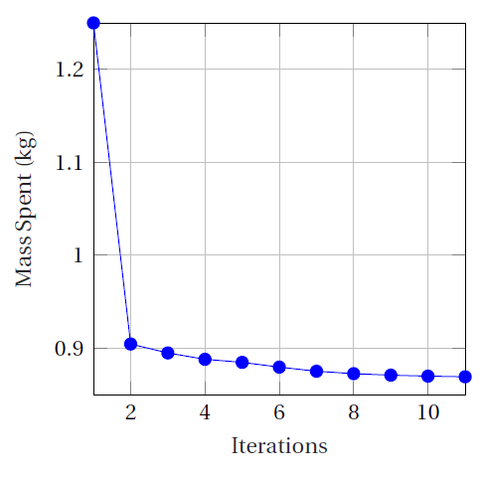
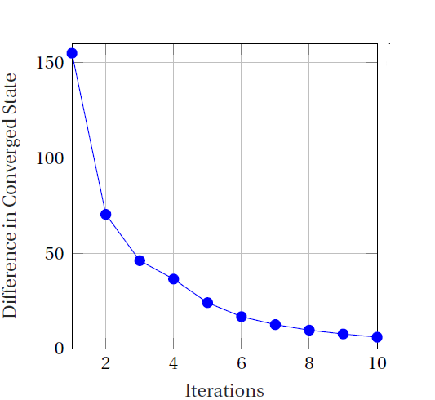
Dynamic Successive Convex Optimisation (Mars 6DOF)
Introduction
Research Question
Mission Overview
Methodology
Simulator Verification
Results
Conclusions
Recommendations
Figure 24: Trajectory convergence with dynamic SCvx CQ algorithm for Szmuk et al. (2017) test case.

Slide 36
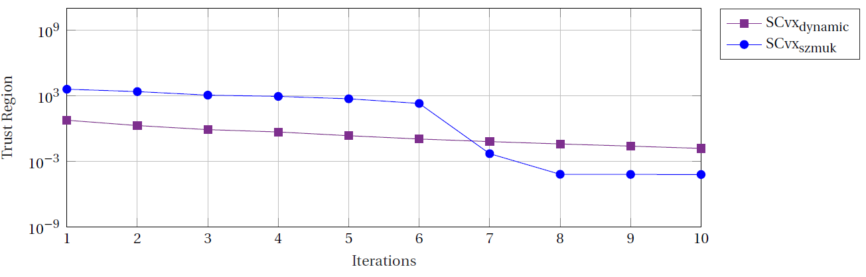
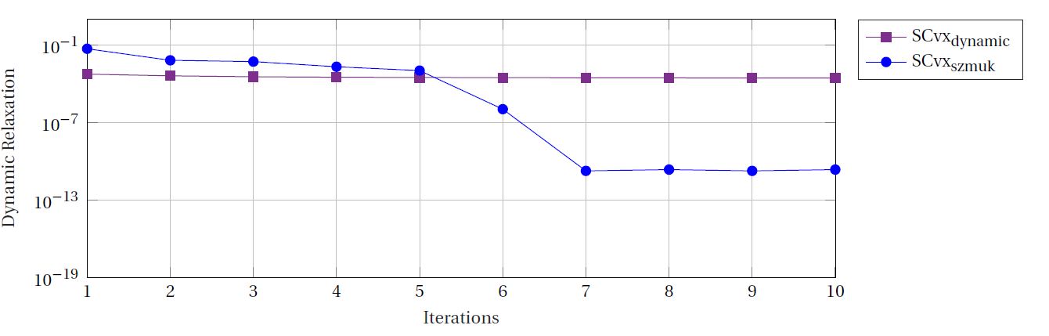
Dynamic Successive Convex Optimisation (Mars 6DOF)
Introduction
Research Question
Mission Overview
Methodology
Simulator Verification
Results
Conclusions
Recommendations

Slide 37
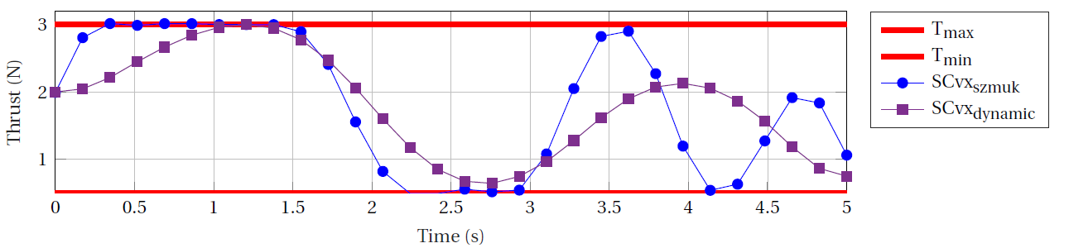
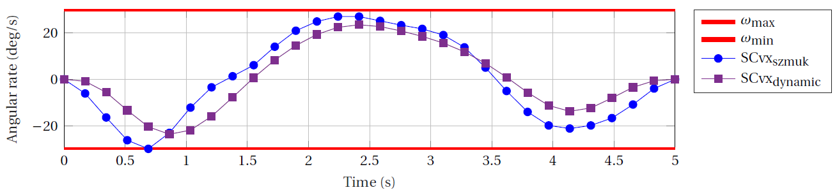
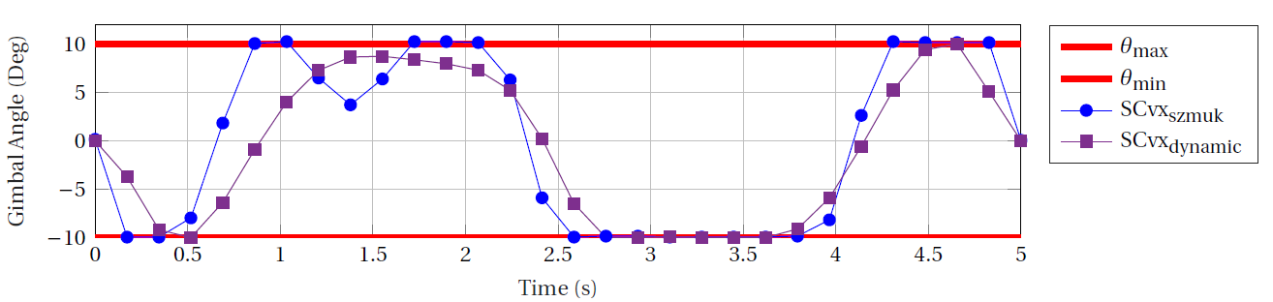
Dynamic Successive Convex Optimisation (Mars 6DOF)
Introduction
Research Question
Mission Overview
Methodology
Simulator Verification
Results
Conclusions
Recommendations

Slide 38
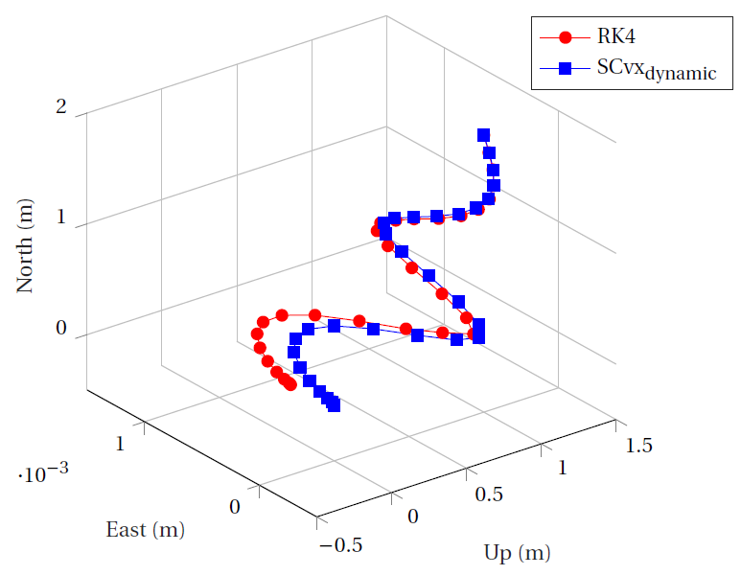
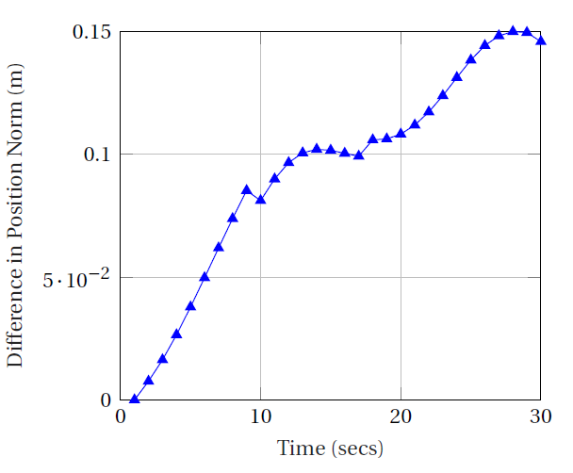
Dynamic Successive Convex Optimisation (Mars 6DOF)
Introduction
Research Question
Mission Overview
Methodology
Simulator Verification
Results
Conclusions
Recommendations
Figure 25: Comparison of RK4 integrator with dynamic SCvx algorithm results.

Slide 39
Simulator Verification: Dynamic SCvx Algorithm with Dual Quaternions

Slide 40
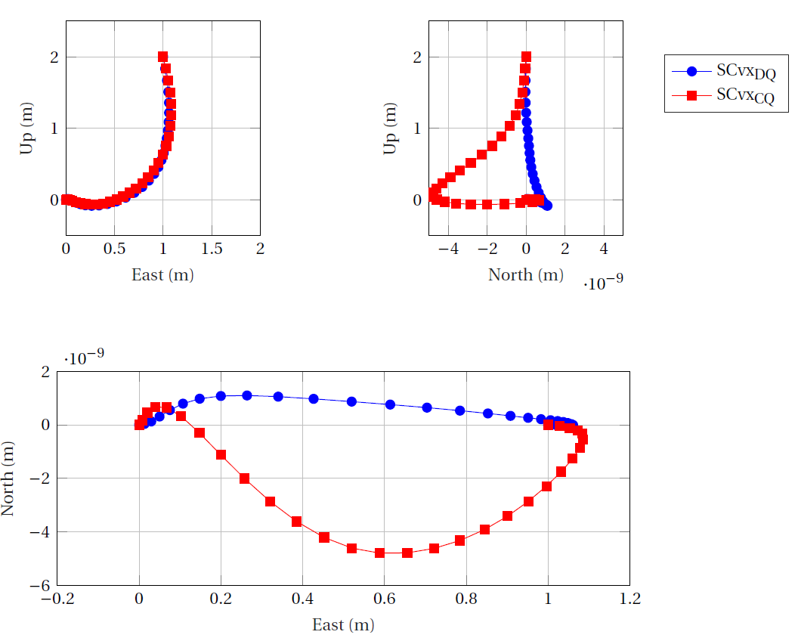
Dynamic Successive Convex Optimisation (Mars 6DOF DQs)
Introduction
Research Question
Mission Overview
Methodology
Simulator Verification
Results
Conclusions
Recommendations
Figure 26: Trajectory (10th iteration) comparison between dynamic SCvx DQ algorithm and the SCvx dynamic CQ algorithm for Szmuk et al. (2017) test case with glide slope constraint switched off.

Slide 41
Dynamic Successive Convex Optimisation (Mars 6DOF DQs)
Introduction
Research Question
Mission Overview
Propellant consumption is reduced in the range of 10E-2
Thrust and angular profiles follow a similar trend as Cartesian Quaternion algorithm
Trust region radii and virtual controls are lowered in the range of 10E-1
All constraints besides glide-slope are active and met by the algorithm
Methodology
Simulator Verification
Results
Conclusions
Recommendations

Slide 42
Results: Descent

Slide 43
Scenario 1 Test Case and Results from dynamic SCvx CQ algorithm
Introduction
Table 4: Algorithm Parameters for Scenario 1
Research Question
Mission Overview
Methodology
Table 6: Final state for Scenario 1 from dynamic SCvx CQ algorithm
Simulator Verification
Results
Conclusions
Recommendations
Table 5: Simulation Parameters for Scenario 1

Slide 44
Scenario 1 Convergence Plots
Introduction
Research Question
Mission Overview
Methodology
Simulator Verification
Results
Conclusions
Recommendations
Figure 27: Trajectory convergence with dynamic SCvx CQ algorithm for Scenario 1.

Slide 45
Scenario 1 Convergence Plots
Introduction
Research Question
Mission Overview
Methodology
Simulator Verification
Results
Conclusions
Recommendations

Slide 46
Scenario 1 Convergence Plots
Introduction
Research Question
Mission Overview
Methodology
Simulator Verification
Results
Conclusions
Recommendations

Slide 47
Scenario 2 Test Case and Results from dynamic SCvx CQ algorithm
Introduction
Table 7: Algorithm Parameters for Scenario 2
Research Question
Mission Overview
Methodology
Table 9: Final state for Scenario 2 from dynamic SCvx CQ algorithm
Simulator Verification
Results
Conclusions
Recommendations
Table 8: Simulation Parameters for Scenario 2

Slide 48
Scenario 2 Convergence Plots
Introduction
Research Question
Mission Overview
Methodology
Simulator Verification
Results
Conclusions
Recommendations
Figure 28: Trajectory convergence with dynamic SCvx CQ algorithm for Scenario 2.

Slide 49
Scenario 2 Convergence Plots
Introduction
Research Question
Mission Overview
Methodology
Simulator Verification
Results
Conclusions
Recommendations

Slide 50
Scenario 2 Convergence Plots
Introduction
Research Question
Mission Overview
Methodology
Simulator Verification
Results
Conclusions
Recommendations

Slide 51
Scenario 2 Convergence Plots
Introduction
Research Question
Mission Overview
Methodology
Simulator Verification
Results
Conclusions
Recommendations

Slide 52
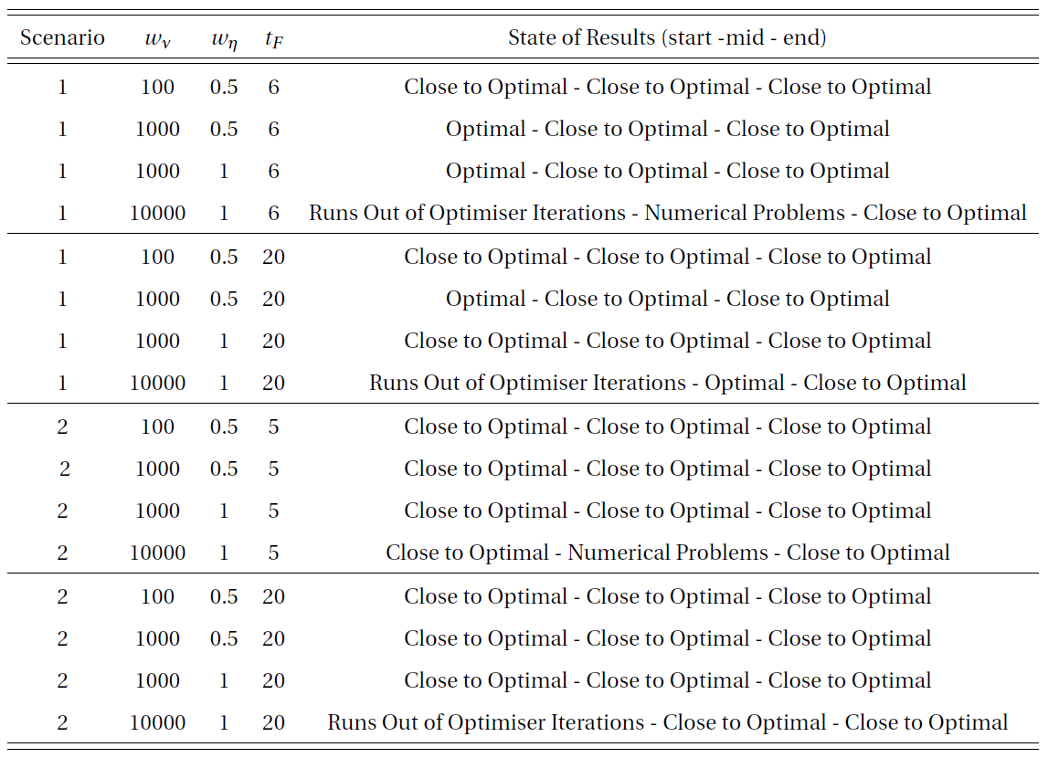
DQ Scenario 1 and 2
Introduction
Research Question
Mission Overview
Methodology
Simulator Verification
Results
Conclusions
Recommendations

Slide 53
Results: Mapping

Slide 54

Asteroid Mapping Initialisation
Introduction
Research Question
Mission Overview
Methodology
Simulator Verification
Results
Conclusions
Recommendations

Slide 55

Asteroid Mapping Initialisation
Introduction
Research Question
Mission Overview
Methodology
Simulator Verification
Results
Conclusions
Recommendations

Slide 56
Dynamic SCvx method does prove to be a method to enable autonomous guidance for an accurate and safe asteroid descent, but it requires some further research to be robust and stable.
The dynamic iterative process, converges to give a lower thrust profile, which means lower propellant consumption as compared to Szmuk et al. (2017).
The iterative DQ successive convexification method converges in less than 10 iterations within 7 secs (optimiser time) for the Mars descent and therefore can be implemented in a real time application
6DOF relative frame dynamics with DQs have been derived and verified for the purpose of this thesis and can be used for further research work.
A complex relationship between penalty weight values, the propellant mass to be optimised, the sensitivity of ECOS to scaling and final time has been found and needs further research.
Initial framework and underlying logic from SBMPO has been established for future work.
Introduction
Research Question
Mission Overview
Methodology
Simulator Verification
Results
Conclusions
Recommendations

Slide 57
The SMBPO algorithm needs to be completed to lead to lower global mapping phase times for actual missions.
An optimal time to go algorithm should be implemented for the descent phase.
The exact relation between the scale of the penalty weights for virtual controls and trust region and non linear constraints has to be figured out.
Use of other convex optimisers with the SCvx problem needs to be investigated for better performance under badly scaled problem parameters.
Hazard Detection and Avoidance, should also be incorporated to verify the capabilities of the SCvx algorithm to deal with diversions.
To evaluate the advantages of the SCvx guidance, it is necessary to have comparisons with other guidance technologies available.
Introduction
Research Question
Mission Overview
Methodology
Simulator Verification
Results
Conclusions
Recommendations
Notes:
since automated trajectories would lead to the spacecraft spending more time on well illuminated and interesting sites to select a descent site for the TAG descent phase.
so that the final time need not be found by trial and error

Slide 58
References
https://www.space.com/30213-asteroid-mining-planetary-resources-2025.html
https://www.nasa.gov/content/what-is-nasa-s-asteroid-redirect-mission
https://www.asteroidmission.org/?latest-news=nasa-mission-reveals-asteroid-big-surprises
https://www.extremetech.com/extreme/286238-hayabusa-2-successfully-collects-sample-from-asteroid-ryugu
Szmuk, M., Utku, E., and Açıkme¸se, B. “Successive Convexification for Mars 6-DoF Powered Descent Landing Guidance”. AIAA Guidance, Navigation, and Control Conference. (2017).

Slide 59
Questions?
Thank You!

Slide 60


Dynamic Successive Convex Optimisation (Mars 6DOF DQs)
Introduction
Research Question
Mission Overview
Methodology
Simulator Verification
Results
Conclusions
Recommendations

Slide 61


Dynamic Successive Convex Optimisation (Mars 6DOF DQs)
Introduction
Research Question
Mission Overview
Methodology
Simulator Verification
Results
Conclusions
Recommendations

Slide 62

SC Structure Models
Introduction
Research Question
Mission Overview
Methodology
Simulator Verification
Results
Conclusions
Recommendations
Figure 21: Inertial change of Rosetta with △v usage till 50 m/s.

Slide 63
The glide-slope and line of sight constraint need to be incorporated intelligently.
Higher order discretisation has been encoded in the algorithm, but needs some work to be actually implemented.
Better control can be obtained with FOH and should be looked into as further work.
Another effort to make the SCvx algorithm more global is to work with different landing scenarios.
To make the SCvx algorithm compatible with a GNC system, a closed loop GNC simulator needs to be built.
SRP and 3rdBP perturbations should also be added to obtain a more accurate achievable precision.
Simulations with spherical gravity and gravity from spherical harmonics should also be considered in future work.
The algorithms for both mapping and descent should be coded using compiled languages like C or C++ to obtain better computational speeds.
Introduction
Research Question
Mission Overview
Methodology
Simulator Verification
Results
Conclusions
Recommendations

Slide 64

Asteroid Mapping Initialisation
Introduction
Research Question
Mission Overview
Methodology
Simulator Verification
Results
Conclusions
Recommendations

Slide 65

Asteroid Mapping Initialisation
Introduction
Research Question
Mission Overview
Methodology
Simulator Verification
Results
Conclusions
Recommendations

Slide 66

Asteroid Mapping Initialisation
Introduction
Research Question
Mission Overview
Methodology
Simulator Verification
Results
Conclusions
Recommendations

